Slide 1
2024-2025
Tell Me About the FAFSA Answers to FAQs Regarding Federal Financial Aid for College

Slide 2
Intro to the FAFSA Modules
The Free Application for Federal Student Aid, or FAFSA, is your key to unlocking federal and state financial aid that may be available to help you pay for your college expenses at a technology center, career school, college or university. The FAFSA is NOT a loan application, a credit search, or an application to college. It’s simply a ‘snapshot’ of your family’s financial situation on the day you submit the form.
A new FAFSA becomes available October 1* every year, and it will cover the academic term that will start the following fall. This means if you’re a high school senior, you should submit your FAFSA as early as possible to see how much aid you qualify for to help you pay for college.
*The 2024-25 FAFSA was released December 2023, but the regular release date will go back to October 1 in 2024.

Slide 3
FAFSA Eligibility
The FAFSA won’t ask about your grades, because your eligibility for federal financial aid isn’t based on your academic performance in high school. To be eligible to receive federal financial aid, you must:
Be a U.S. citizen or eligible noncitizen
Have a valid Social Security Number or Permanent Resident Card (green card) (more details about eligible noncitizens)
Have a high school diploma or GED, or have graduated from a state-approved homeschool setting
Make Satisfactory Academic Progress (SAP) while in college; ask your school(s) of interest about their SAP policy

Slide 4
FAFSA Benefits
The FAFSA will help determine your eligibility for:
Federal Financial Aid
Grants
Work-study program
Student loans
State Financial Aid
Grants
Scholarships
You’re required to renew your FAFSA each year that you’re in college if you receive the Oklahoma’s Promise scholarship
Generally, scholarships from state and private funds will require their own separate applications

Slide 5
FAFSA Learning Modules
The following modules will walk you through the FAFSA process. Beginning with Module 1, complete each module in order. If you don’t finish all five in one sitting, no problem! Just remember where you stopped, and then pick up where you left off.
Module 1: Gather Your Information
Module 2: Create an FSA ID
Module 3: Complete Your FAFSA
Module 4: Summary, Sign and Submit
Module 5: Follow Up

Slide 6
Learning Module 1: Gather Your Information
2024-2025
Tell Me About the FAFSA Answers to FAQs Regarding Federal Financial Aid for College

Slide 7
Gather Your Information
Your Social Security Number – best to have your card with you or your current Permanent Resident Card
Your first and last names – exactly as they appear on your Social Security card
Your date of birth
Your complete address, including zip code
Your Federal Student Aid ID, or FSA ID (See Module 2 for more information)
You will need the following information to complete your FAFSA
That’s not all! Keep going!

Slide 8
Gather Your Information
Your total earned income for the year specified on the FAFSA, which will be two years prior to the year you begin college
If you filed a tax return, bring a copy of it with you
Bring your W-2s, be prepared to report an estimate of all earned income for the year
Your current balance of cash, savings, and checking accounts
Don’t forget these!

Slide 9
Gather Your Information
If you’re a dependent student, you will need to provide parental information on the FAFSA
If you’re an independent student, you will have to provide only your information and that of a spouse, if you’re married
To help you determine your dependency status, see UCanGo2’s Dependency Questionnaire.
You may also need to provide your parent’s information on your FAFSA

Slide 10
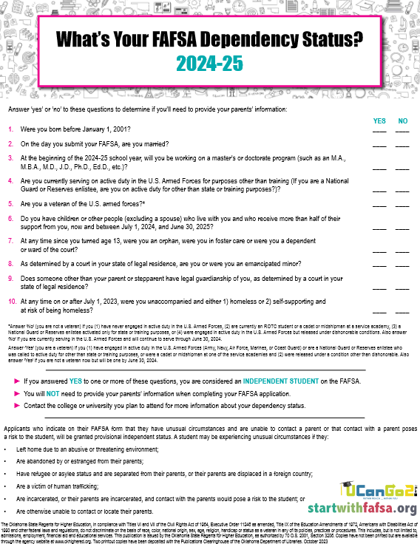
UCanGo2 Dependency Questionnaire
Determine if you’ll be considered dependent or independent when completing the FAFSA
If you answer ‘YES’ to one question, you’ll be considered an independent student
Independent students don’t need to provide parental information on the FAFSA
Dependent students will provide parental information on the FAFSA
If you cannot provide parental information, please follow the directions on the FAFSA

Slide 11
Gathering Your Information
Parents of dependent students will also need to provide the information listed in the previous slides for the student.
In addition, they’ll need to report:
Current marital status
Net worth of current investments
Current business and farm value, value of stocks, bonds, and real estate (excluding your primary residence)
Total child support received for the year
You’ll need to gather some of your parents’ information, too!

Slide 12
Gathering Your Information
A parent without a Social Security Number (SSN) can fill out the FAFSA for their student. The SSN field will be blank and disabled on the FAFSA form if the parent indicates they don’t have an SSN.
Parents without SSNs are now required to create an FSA ID. See information on the creation process here.
More about parents!

Slide 13
Creating an FSA ID with
NO Social Security Number
Learn about the FSA ID, what it’s used for, and how a parent may create one without having a Social Security Number
This feature is new to the 2024-25 FAFSA

Slide 14
Gathering Your Information
If you’re a Dependent student, at least one of your parents will also need to create an FSA ID. Review the Who Needs a Federal Student Aid ID? flowchart for details.
See Module 2 for more information!
FSA ID

Slide 15
Who Needs a Federal Student Aid ID?
Follow the flowchart to determine if one or both of your parents may need to create an FSA ID to complete the FAFSA

Slide 16
Creating an FSA ID
Learn about the FSA ID, what it’s used for, and how to create one in order to complete and sign the FAFSA.

Slide 17
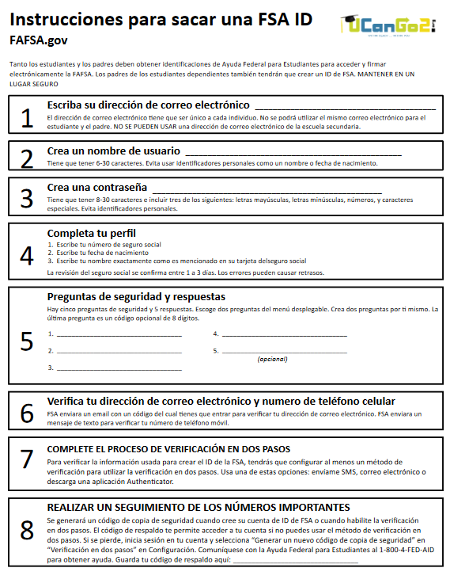
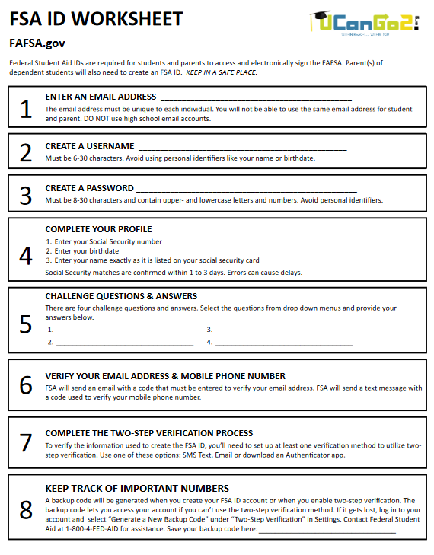
FSA ID Worksheets
The FSA ID Worksheet comes in English and Spanish
It’s a great way to keep track of the information you use to create your FSA ID

Slide 18
Gathering Your Information
Question 1: Which students are required to include their parents’ information on the FAFSA?
Dependent Students
Independent Students
Question 2: Which of these will you need to have with you when you fill out your FAFSA?
Amount of income earned from two years prior to the year you will attend college
Credit card balance
Your high school GPA
All of the above
QUIZ!

Slide 19
Gathering Your Information
Question 1: Which students are required to include their parents’ information on the FAFSA?
Dependent students
Question 2: Which of these will you need to have with you when you fill out your FAFSA?
Amount of income earned from two years prior to the year you will attend college
The FAFSA will always ask for the amount of income you and your parents earned from two years prior to the year you will start college. For example, if you start college in the fall of 2024, you will provide income from 2022 on the FAFSA.
Answers!

Slide 20
Tell Me About the FAFSA Answers to FAQs Regarding Federal Financial Aid for College
Answers to FAQs Regarding Federal Financial Aid for College
Learning Module 2: Create an FSA ID
2024-2025

Slide 21
What is an FSA ID?
FSA ID = Federal Student Aid Identification
Will serve as your unique electronic signature when you complete your FAFSA
Will serve as your unique electronic signature if borrow a federal student loan
Will be required for all students and parents completing the FAFSA
FSA takes 3-5 days to process
Everyone who creates an FSA ID should start the process a week before beginning their FAFSA

Slide 22
What is an FSA ID?
FSA ID is essentially your username and password for the FAFSA
Visit StudentAid.gov/fsa-id/create-account/launch to create your FSA ID
FSA ID will be required every time you log in to the FAFSA
If you’re a dependent student, one or more parents will also need an FSA ID
A parent’s FSA ID is created the same way as the student’s FSA ID
Each individual creating an FSA ID will need to have their own separate email address
Parents without a Social Security Number will now be allowed to create an FSA ID

Slide 23
FSA ID Tips
Enter your name and SSN exactly as they appear on your Social Security card
Use a personal email address (not one from your school or place of employment)
Provide a permanent mailing address (best to use your parents’ address)
Cannot use the same email and/or phone number as your parent, if they will be creating an FSA ID

Slide 24
FSA ID
To verify your information when you access the FAFSA form, Federal Student Aid recommends that you set up an authentication method to utilize two-step verification. You may use one of these methods:
SMS Text
Email
Authenticator App
Google Authenticator
Microsoft Authenticator
Authy
LastPass
DuoMobile
Download an authenticator app from Federal Student Aid
Two-Step Verification

Slide 25
One-Use Backup Code
A one-use backup code will be generated when you create your FSA ID account or when you enable two-step verification. This backup code lets you access your account if you can’t use the two-step verification method.
Store your backup code somewhere safe. If it gets lost, log in to your account and select “Generate a New Backup Code” under “Two-Step Verification” in Settings. If this doesn’t work, contact Student Aid at 800-4-FED-AID (800-433-3243) for assistance.
NOTE: Your backup code can only be used once.

Slide 26
Create an FSA ID
Are you currently homeless or self-supporting and at risk of being homeless? Follow these instructions when providing a mailing address for your FSA ID and on your FAFSA.
With permission, provide either
The permanent mailing address of a relative or
The address of one of the offices at the college you’ll be attending
Homeless Students

Slide 27
Create an FSA ID
Don’t allow anyone to create your FSA ID for you
Don’t create an FSA ID for someone else
Don’t share your FSA ID with anyone – not even your parents
Your parents can access your FAFSA with their own FSA ID
More instructions in Module 4
Additional Guidelines

Slide 28
Create an FSA ID
If your parents do not have a Social Security Number, they can still create an FSA ID, but there will be alternative methods of confirming their identity.
FSA will match their identity using TransUnion services to ask knowledge-based questions to help with identity verification. Examples of these questions may include:
Current or former address
A previous phone number
A previous employer
Details about a home or auto loan
Parents without SSN

Slide 29
Create an FSA ID
If a parent is unable to successfully answer the online questions, they will receive an email directing them to submit certain documents to Federal Student Aid. They will need to call the FSA Information Center (800-433-3243) to receive a case number and further instructions for submitting the required documents. Each person will need to complete an Attestation and Validation of Identity form that will be available on StudentAid.gov and submit a driver’s license, state ID or foreign passport to complete the process.
Parents without SSN

Slide 30
To create your FSA ID, go to: StudentAid.gov and choose to Create Account.

Slide 31
Quiz
Question 1: Why do I need an FSA ID?
To access my FAFSA
It’s my unique electronic signature
To sign my student loan application
All of the above
Question 2: True or False? It’s OK for me to give my parents my FSA ID so they can complete their information on my FAFSA later.
True
False
Create an FSA ID

Slide 32
Quiz Answers
Question 1: Why do I need an FSA ID?
D. All of the above
Question 2: True or False? It’s OK for me to give my parents my FSA ID so they can complete their information on my FAFSA later.
False. You should never share your FSA ID with anyone. Your parents will be able to access your FAFSA another way.
Create an FSA ID

Slide 33
Tell Me About the FAFSA Answers to FAQs Regarding Federal Financial Aid for College
Answers to FAQs Regarding Federal Financial Aid for College
Learning Module 3: Complete Your FAFSA
2024-2025

Slide 34
Complete your FAFSA
Module 3 is divided into seven sections. To begin the module, start at section 3A, and then continue through the sections in order. If you need to come back later, you can return to this page to find where you left off.
Section 3A – Let’s Get Started
Section 3B – Student Demographics & School Selection
Section 3C – Your Dependency Status
Section 3D – Household Size (for Independent Students)
Section 3E – Your Financial Information
Section 3F – Which Parent’s Income Do I Report? (for Dependent Students)
Section 3G – For Parents of Dependent Students
About Module 3

Slide 35
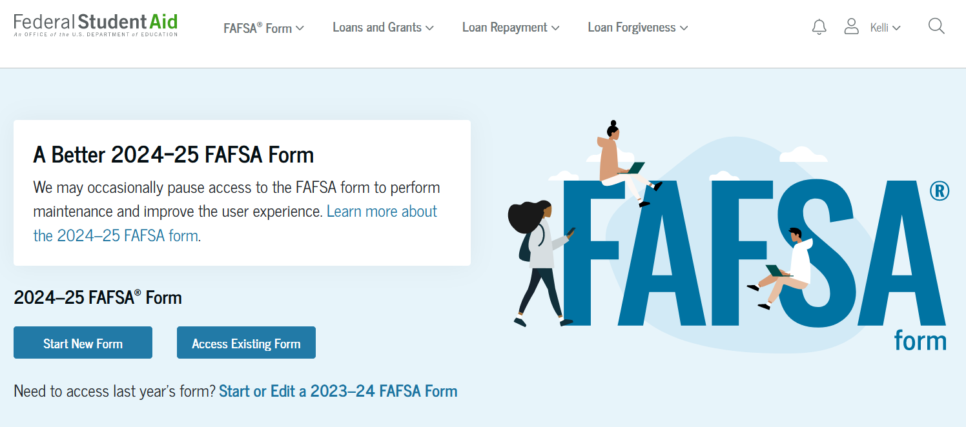
Complete your FAFSA - Section 3A
Let’s Get Started

Slide 36
Complete Your FAFSA
Log in to FAFSA.gov
If you have your FSA ID, click “Start New Form – 2024-25 FAFSA Form”
Choose your status: Student or Parent
If you don’t have your FSA ID, visit StudentAid.gov to create one. You will need the FSA ID to access, complete and electronically sign your FAFSA.

Slide 37
Complete your FAFSA - Section 3B
Student Demographics and School Selection

Slide 38
Complete Your FAFSA
STUDENT DEMOGRAPHICS – Helpful Tips
Enter your name as shown on your Social Security or Permanent Resident Card
Don’t use punctuation – only a hyphen if used on your Social Security Card
Click Save often throughout the application
Student Demographics and School Selection

Slide 39
Complete Your FAFSA
STUDENT DEMOGRAPHICS – Homeless Students
If you are currently homeless or self-supporting and at risk of being homeless, follow these instructions when providing a mailing address for your FSA ID and FAFSA
With permission, provide either
The permanent mailing address of a relative or
The address of an office at the college you’ll be attending
Student Demographics and School Selection

Slide 40
Complete Your FAFSA
STUDENT DEMOGRAPHICS – Grade Level
Will you start college with Advanced Placement or Concurrent enrollment credits?
If you’re applying for your first semester in college, you should indicate your college grade level as “Never attended college,” even if you earned college credit in high school. Remember, those credits were earned before you graduated from high school.
Student Demographics and School Selection

Slide 41
Complete Your FAFSA
SCHOOL SELECTION
The student is asked to search for the colleges and/or career schools they would like to receive their FAFSA information.
The student searches for a school by entering a state, city, and/or school name. After selecting "Search," they select the correct school from the search results.
Students can select to send their FAFSA information to a maximum of 20 schools.
Student Demographics and School Selection

Slide 42
Complete your FAFSA - Section 3C
Your Dependency Status

Slide 43
Complete Your FAFSA
DEPENDENCY QUESTIONS
You’ll be required to answer questions to determine your dependency status
See our Dependency Questionnaire for the list of questions
If you answer NO to every question
You’re a dependent student
You’ll have to include parental information on your FAFSA
If you answer YES to any questions about your personal circumstances
You’re an independent student, and
Parental information is not required
Your Dependency Status

Slide 44
Complete Your FAFSA
PROVISIONAL INDEPENDENT STATUS
Beginning with the 2024-25 award year, dependent students who indicate they have unusual circumstances that may prevent them from providing parent data on the FAFSA, will no longer receive a rejected application. They will instead have their FAFSA processed with a Provisional Independent Status stipulation. This will generate output documents with a provisional SAI (Student Aid Index, formerly known as the EFC, or Expected Family Contribution) and an estimate of federal student aid eligibility. Aid administrators will need to make a final determination as to whether these students should receive a dependency override.
Your Dependency Status

Slide 45
Complete your FAFSA - Section 3D
Household Size, Independent Students
If you are a dependent student, proceed to Section 3E

Slide 46
Complete Your FAFSA
Your household size will be taken directly from the number of dependents included on your and/or your parents’ 2022 income tax form.
You will be given the option to update the number in the household, if the information has changed.
Household Size

Slide 47
Complete your FAFSA - Section 3E
Your Financial Information

Slide 48
Complete Your FAFSA
Why Do I Have to Report My Income?
In order to determine your financial need, any financial aid office will use the data from your FAFSA. They will use a simple formula to determine how much aid they can offer you.
Some forms of aid are based on your financial need, and some are not.
Reporting your income helps to ensure that need-based aid is given to the people who need it the most.
Starting with the 2024-25 FAFSA, all students and parents who contribute information to this form are required to give consent to Federal Student Aid to allow them to transfer your tax information into the FAFSA from the IRS.
Your Financial Information

Slide 49
Complete Your FAFSA
What If I Have No Income To Report?
If you didn’t file a tax return in 2022, you still need to consent to have your tax information downloaded to the FAFSA from the IRS
Just remember that any earned income needs to be reported on your FAFSA, even if you didn’t file a tax return for the required year
Your Financial Information

Slide 50
Complete Your FAFSA
Assets that must be reported on the FAFSA include:
Money in cash, savings, and checking accounts
Business value
Investment farm value
Real estate (other than the home in which you live)
Uniform Gifts to Minors Act (UGMA) and Uniform Transfer to Minors Act (UTMA) accounts for which you are the owner
Stocks, bonds, certificates of deposit, etc.
Child support received
Your Financial Information

Slide 51
Tell Me About the FAFSA Answers to FAQs Regarding Federal Financial Aid for College
Answers to FAQs Regarding Federal Financial Aid for College
Learning Module 4: Summary, Sign and Submit
2024-2025

Slide 52
Summary, Sign and Submit
You’re almost there!
Once all your data has been entered, you’ll be taken to the Summary page
In this section you’ll be allowed to review all the answers you’ve provided on the FAFSA. Please make sure everything looks accurate before you move on.
Because you logged in to the FAFSA with your FSA ID, the FAFSA will most likely state that you have already signed using your ID
If your parent hasn’t completed their portion of the FAFSA, you will be unable to submit the form.
Review,
Student and Parent Signatures,
Submit

Slide 53
Summary, Sign and Submit
Your parent(s) will use their FSA ID to sign the FAFSA electronically.
If they have completed their portion of the FAFSA last, they will be able to submit the form.
If the parent completed their portion of the FAFSA first, the student will be able to submit the form once their section has been finished.
Parent’s Signature

Slide 54
Sign and Submit
Question 1: True or False? If I find an error on my Summary page, I can make the correction then.
True
False
Question2: True or False? Unless I click “Submit” at the end of my application, my FAFSA won’t be processed by Federal Student Aid.
True
False
Quiz!

Slide 55
Sign and Submit
Question 1: True or False? If I find an error on my Summary page, I can make the correction then.
A. True
Question 2: True or False? Unless I click “Submit” at the end of my application, my FAFSA won’t be processed by Federal Student Aid.
A. True
Answers!

Slide 56
Tell Me About the FAFSA Answers to FAQs Regarding Federal Financial Aid for College
Answers to FAQs Regarding Federal Financial Aid for College
Learning Module 5 – Follow Up
2024-2025

Slide 57
Follow Up
After you submit your FAFSA, watch for an email from Federal Student Aid (the letters FSA will appear in the sender’s address)
The message will say that your FAFSA has been received and is being processed
If you don’t receive it soon, check your spam and/or junk mail
In a few days, you’ll receive an email instructing you on how to view your FAFSA Submission Summary
FAFSA Submission Summaries are being delayed until late January or early February for the 2024-25 FAFSA form
What’s Next?

Slide 58
Follow Up
Read through your FAFSA Submission Summary and check for errors. There will be four tabs.
On the Eligibility Overview tab, the student sees information about the federal student aid they may be eligible for, such as a Federal Pell Grant and Federal Direct Loans. They can also view their Student Aid Index (SAI).
On the FAFSA Form Answers tab, the student sees the answers they and, if applicable, their contributor(s) provided on the FAFSA® form. If any of the provided answers are incorrect, the student can choose to make corrections.
Your FAFSA Submission Summary

Slide 59
Follow Up
On the School Information tab, the student sees information about the college(s) and/or career school(s) they selected to send their FAFSA® information. The student can compare the graduation rate, retention rate, transfer rate, default rate, median debt upon completion, and average annual cost of their selected schools.
On the Next Steps tab, the student sees comments that pertain to their FAFSA® form. Some comments may require the student to start a correction or send additional documentation to their school. Other comments may be informational and do not require any further action from the student.
Your FAFSA Submission Summary

Slide 60
Sample FAFSA Submission Summary

Slide 61
Follow Up
Once processed, the data you submitted will also be sent to all the schools you included on your FAFSA.
Some schools may contact you, but others may not. If a school you’re interested in hasn’t contacted you within a few weeks, call the financial aid office to verify they’ve received your information.
A college must have your processed data before they can offer you any financial aid. Some colleges may require that you’ve been approved for admission at their school before offering financial assistance.
If you’d like to add another school code after you’ve received your FAFSA Submission Summary, log in to your FAFSA at FAFSA.gov and edit your FAFSA.
Your Information

Slide 62
Follow Up
In order for the financial aid office to be able to award you aid, your FAFSA must be fully processed – not only by Federal Student Aid’s automated system, but also by different offices at your college.
If your FAFSA was selected for verification, all additional documentation must also be provided, reviewed and approved.
These requirements are based on federal and state law.
Your patience is greatly appreciated by everyone involved in the process.
An Important Note

Slide 63
Follow Up
College staff know exactly how to guide you from here. Be sure to ask questions about anything you have on your mind.
Some common offices to contact during your first year are:
Admission
Financial Aid
Registrar (Enrollment)
Bursar (Financial Services)
Student Housing & Parking
Student Life Center
Ask the Experts

