Slide 1


Tell Me About the FAFSA
Answers to FAQs Regarding Federal Financial Aid for College
Answers to FAQs Regarding Federal Financial Aid for College
Learning Module 3: Complete Your FAFSA
2024-2025

Slide 2
Complete your FAFSA
Module 3 is divided into seven sections. To begin the module, start at section 3A, and then continue through the sections in order. If you need to come back later, you can return to this page to find where you left off.
Section 3A – Let’s Get Started
Section 3B – Student Demographics & School Selection
Section 3C – Your Dependency Status
Section 3D – Household Size (for Independent Students)
Section 3E – Your Financial Information
Section 3F – Which Parent’s Income Do I Report? (for Dependent Students)
Section 3G – For Parents of Dependent Students
About Module 3

Slide 3
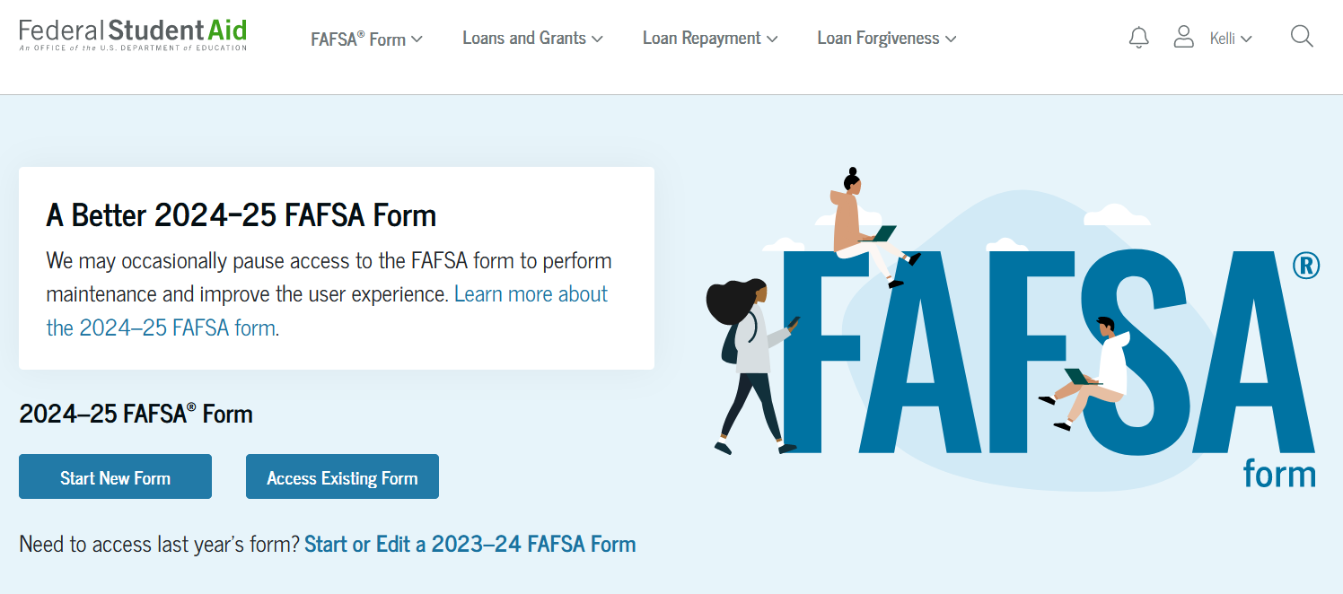
Complete your FAFSA - Section 3A
Let’s Get Started

Slide 4
Complete Your FAFSA
Log in to FAFSA.gov
If you have your FSA ID, click “Start New Form – 2024-25 FAFSA Form”
Choose your status: Student or Parent
If you don’t have your FSA ID, visit StudentAid.gov to create one. You will need the FSA ID to access, complete and electronically sign your FAFSA.

Slide 5
Complete your FAFSA - Section 3B
Student Demographics and School Selection

Slide 6
Complete Your FAFSA
STUDENT DEMOGRAPHICS – Helpful Tips
Enter your name as shown on your Social Security or Permanent Resident Card
Don’t use punctuation – only a hyphen if used on your Social Security Card
Click Save often throughout the application
Student Demographics and School Selection

Slide 7
Complete Your FAFSA
STUDENT DEMOGRAPHICS – Homeless Students
If you are currently homeless or self-supporting and at risk of being homeless, follow these instructions when providing a mailing address for your FSA ID and FAFSA
With permission, provide either
  The permanent mailing address of a relative or
  The address of an office at the college you’ll be attending
Student Demographics and School Selection

Slide 8
Complete Your FAFSA
STUDENT DEMOGRAPHICS – Grade Level
Will you start college with Advanced Placement or Concurrent enrollment credits?
If you’re applying for your first semester in college, you should indicate your college grade level as “Never attended college,” even if you earned college credit in high school. Remember, those credits were earned before you graduated from high school.
Student Demographics and School Selection

Slide 9
Complete Your FAFSA
SCHOOL SELECTION
The student is asked to search for the colleges and/or career schools they would like to receive their FAFSA information.
The student searches for a school by entering a state, city, and/or school name. After selecting "Search," they select the correct school from the search results.
Students can select to send their FAFSA information to a maximum of 20 schools.
Student Demographics and School Selection

Slide 10
Complete your FAFSA - Section 3C
Your Dependency Status

Slide 11
Complete Your FAFSA
DEPENDENCY QUESTIONS
You’ll be required to answer questions to determine your dependency status
See our Dependency Questionnaire for the list of questions
If you answer NO to every question
  You’re a dependent student
  You’ll have to include parental information on your FAFSA
If you answer YES to any questions about your personal circumstances
  You’re an independent student, and
  Parental information is not required
Your Dependency Status

Slide 12
Complete Your FAFSA
PROVISIONAL INDEPENDENT STATUS
Beginning with the 2024-25 award year, dependent students who indicate they have unusual circumstances that may prevent them from providing parent data on the FAFSA, will no longer receive a rejected application. They will instead have their FAFSA processed with a Provisional Independent Status stipulation. This will generate output documents with a provisional SAI (Student Aid Index, formerly known as the EFC, or Expected Family Contribution) and an estimate of federal student aid eligibility. Aid administrators will need to make a final determination as to whether these students should receive a dependency override.
Your Dependency Status

Slide 13
Complete your FAFSA - Section 3D
Household Size, Independent Students
If you are a dependent student, proceed to Section 3E

Slide 14
Complete Your FAFSA
Your household size will be taken directly from the number of dependents included on your and/or your parents’ 2022 income tax form.
You will be given the option to update the number in the household, if the information has changed.
Household Size

Slide 15
Complete your FAFSA - Section 3E
Your Financial Information

Slide 16
Complete Your FAFSA
Why Do I Have to Report My Income?
In order to determine your financial need, any financial aid office will use the data from your FAFSA. They will use a simple formula to determine how much aid they can offer you.
Some forms of aid are based on your financial need, and some are not.
Reporting your income helps to ensure that need-based aid is given to the people who need it the most.
Starting with the 2024-25 FAFSA, all students and parents who contribute information to this form are required to give consent to Federal Student Aid to allow them to transfer your tax information into the FAFSA from the IRS.
Your Financial Information

Slide 17
Complete Your FAFSA
What If I Have No Income To Report?
If you didn’t file a tax return in 2022, you still need to consent to have your tax information downloaded to the FAFSA from the IRS
Just remember that any earned income needs to be reported on your FAFSA, even if you didn’t file a tax return for the required year
Your Financial Information

Slide 18
Complete Your FAFSA
Assets that must be reported on the FAFSA include:
Money in cash, savings, and checking accounts
Business value
Investment farm value
Real estate (other than the home in which you live)
Uniform Gifts to Minors Act (UGMA) and Uniform Transfer to Minors Act (UTMA) accounts for which you are the owner
Stocks, bonds, certificates of deposit, etc.
Child support received
Your Financial Information

