Slide 1
Learning Module 1: Gather Your Information
2024-2025
Tell Me About the FAFSA Answers to FAQs Regarding Federal Financial Aid for College

Slide 2
Gather Your Information
Your Social Security Number – best to have your card with you or your current Permanent Resident Card
Your first and last names – exactly as they appear on your Social Security card
Your date of birth
Your complete address, including zip code
Your Federal Student Aid ID, or FSA ID (See Module 2 for more information)
You will need the following information to complete your FAFSA
That’s not all! Keep going!

Slide 3
Gather Your Information
Your total earned income for the year specified on the FAFSA, which will be two years prior to the year you begin college
If you filed a tax return, bring a copy of it with you
Bring your W-2s, be prepared to report an estimate of all earned income for the year
Your current balance of cash, savings, and checking accounts
Don’t forget these!

Slide 4
Gather Your Information
If you’re a dependent student, you will need to provide parental information on the FAFSA
If you’re an independent student, you will have to provide only your information and that of a spouse, if you’re married
To help you determine your dependency status, see UCanGo2’s Dependency Questionnaire.
You may also need to provide your parent’s information on your FAFSA

Slide 5
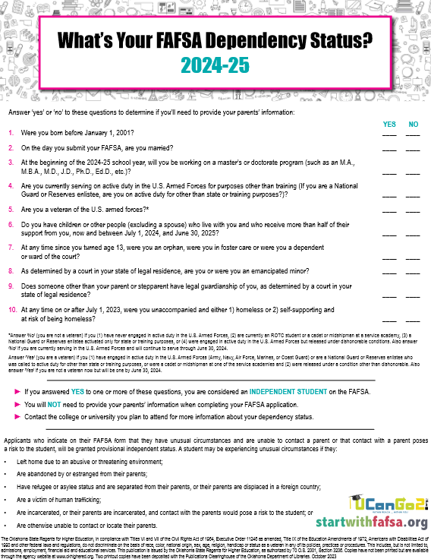
UCanGo2 Dependency Questionnaire
Determine if you’ll be considered dependent or independent when completing the FAFSA
If you answer ‘YES’ to one question, you’ll be considered an independent student
Independent students don’t need to provide parental information on the FAFSA
Dependent students will provide parental information on the FAFSA
If you cannot provide parental information, please follow the directions on the FAFSA

Slide 6
Gathering Your Information
Parents of dependent students will also need to provide the information listed in the previous slides for the student.
In addition, they’ll need to report:
Current marital status
Net worth of current investments
Current business and farm value, value of stocks, bonds, and real estate (excluding your primary residence)
Total child support received for the year
You’ll need to gather some of your parents’ information, too!

Slide 7
Gathering Your Information
A parent without a Social Security Number (SSN) can fill out the FAFSA for their student. The SSN field will be blank and disabled on the FAFSA form if the parent indicates they don’t have an SSN.
Parents without SSNs are now required to create an FSA ID. See information on the creation process here.
More about parents!

Slide 8
Creating an FSA ID with
NO Social Security Number
Learn about the FSA ID, what it’s used for, and how a parent may create one without having a Social Security Number
This feature is new to the 2024-25 FAFSA

Slide 9
Gathering Your Information
If you’re a Dependent student, at least one of your parents will also need to create an FSA ID. Review the Who Needs a Federal Student Aid ID? flowchart for details.
See Module 2 for more information!
FSA ID

Slide 10
Who Needs a Federal Student Aid ID?
Follow the flowchart to determine if one or both of your parents may need to create an FSA ID to complete the FAFSA

Slide 11
Creating an FSA ID
Learn about the FSA ID, what it’s used for, and how to create one in order to complete and sign the FAFSA.

Slide 12
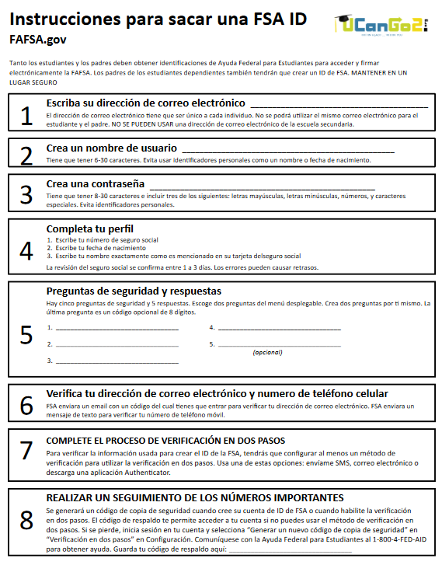
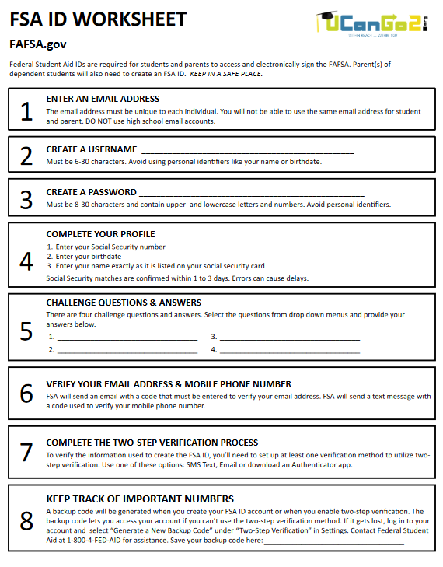
FSA ID Worksheets
The FSA ID Worksheet comes in English and Spanish
It’s a great way to keep track of the information you use to create your FSA ID

Slide 13
Gathering Your Information
Question 1: Which students are required to include their parents’ information on the FAFSA?
Dependent Students
Independent Students
Question 2: Which of these will you need to have with you when you fill out your FAFSA?
Amount of income earned from two years prior to the year you will attend college
Credit card balance
Your high school GPA
All of the above
QUIZ!

Slide 14
Gathering Your Information
Question 1: Which students are required to include their parents’ information on the FAFSA?
Dependent students
Question 2: Which of these will you need to have with you when you fill out your FAFSA?
Amount of income earned from two years prior to the year you will attend college
The FAFSA will always ask for the amount of income you and your parents earned from two years prior to the year you will start college. For example, if you start college in the fall of 2024, you will provide income from 2022 on the FAFSA.
Answers!

