Slide 1
Where Do I Go?
Notes:
UCanGo2 is an initiative designed to provide information about planning, preparing and paying for college.
Workbooks and flyers are provided to students and parents and can be downloaded directly from our college access website, UCanGo2.org.

Slide 2
What is ?
College access program for high school and middle school students and parents
Provides information on how to plan, prepare and pay for college
Helps families create a college-going culture in the home
Notes:
UCanGo2 is an initiative of the Oklahoma College Assistance Program (OCAP) and the Oklahoma State Regents for Higher Education.
UCanGo2 offers college planning information to students and parents.
The Publications link houses several documents and resources that offer valuable tools for anyone considering higher education.
The Scholarship section allows all students to search for scholarships by deadline and category.

Slide 3
Notes:
UCanGo2.org allows users to access the information specific to their needs.
Each section offers resources to middle and high school students, parents and counselors.
Most material can be located and downloaded from the Publications link.
Click on the StartWithFAFSA.org link to find valuable information about the Free Application for Federal Student Aid (FAFSA).

Slide 4
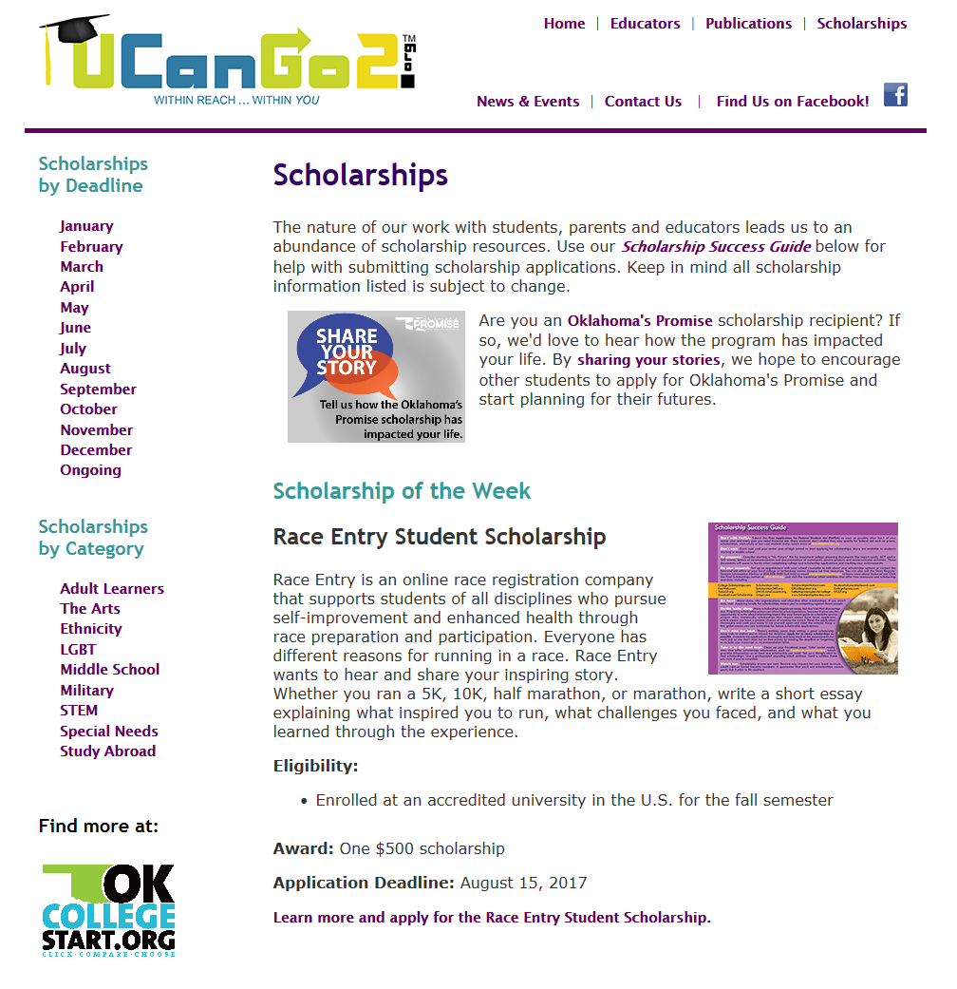
Notes:
In our Scholarship section students will see the Scholarship of the Week, as well as links to scholarships by deadline and category.
At the end of each month’s scholarship descriptions, students will find a list of other scholarships due that particular month.
Scholarships by Category offers several options for students of all ages and interests.

Slide 5
High School Student Workbook
Why Go to College?
What Do I Want to Be?
How Do I Get There?
Where Do I Go?
How Do I Pay For It?
Notes:
The UCanGo2 High School Student Workbook covers five main areas of college planning.
This PowerPoint covers the fourth section, ‘Where Do I Go?’
This section discusses how to choose a college, university, career technology center or proprietary school that’s the best fit for you.
Explains how to set up a successful college visit.
Supplies a list of questions to ask at various offices on a college campus.

Slide 6
What Do You Want In a School?
Type of school
Location
Campus size
Courses offered
Affordability
Admission requirements
Notes:
Choosing a school is an important decision.
Think about all of these factors when making your choice.
Do your research and visit each school you’re seriously interested in attending.

Slide 7
Understanding School Types
Four-Year University
Associate, bachelor’s and graduate degrees
Well-rounded education and flexible degrees
Community College
Associate degrees
Enter the work force after graduation or transfer credits to a four-year university
Technical Branch
Associate and bachelor’s degrees
Education and training in technical fields
Notes:
Can you name a school in each category?

Slide 8
Understanding School Types
Career Technology Center
Certificates in various fields of study
Prepares students for college and careers
Proprietary School
Prepares students for specific occupations
Privately-owned institutions
Private School
Offer education in various fields
Tuition and fees tend to be higher than at public institutions
Notes:
Can you name a school in each category?

Slide 9
Location, Location, Location
Urban
Located in large, metro areas
Have more opportunity for job placement and internships
Typically attract culturally diverse students
Rural
Located in smaller towns that can serve a widespread area
Typically offer more on-campus housing and entertainment
Offer more personalized assistance from professors
Suburban
Usually located in towns where the school’s revenue helps drive the economy
Have amenities located nearby, i.e. laundromat, grocery, bank, Walmart
Offer more on-campus events
Notes:
When choosing a school, location is a big factor.
Read this section of the High School Student Workbook to learn the pros and cons of attending school in a big city versus a small town.

Slide 10
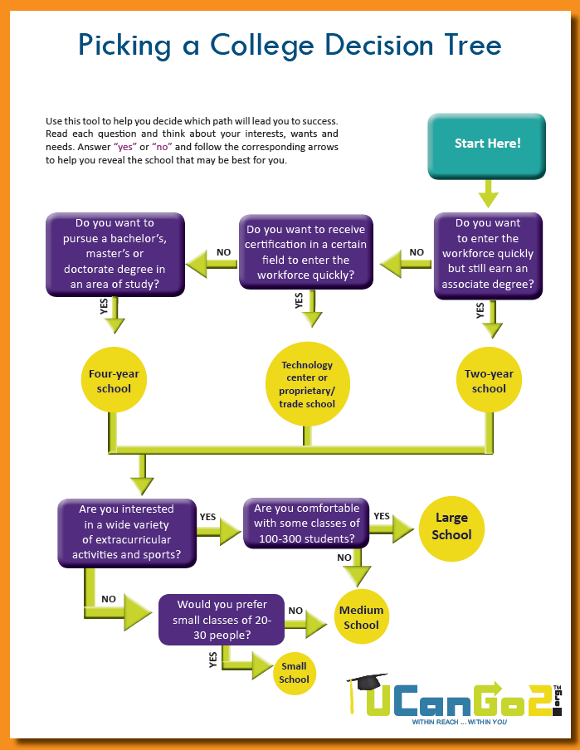
Size Up Your School
Notes:
Will a big school be overwhelming, or do you love to be in large classroom settings?
Will a small school offer you the right classes and extracurricular activities?
Is a medium school just right?

Slide 11
Narrow Down Your Choices
Affordability
Research costs
Visit UCanGo2.org or OKcollegestart.org to learn about ways to pay for college
Apply for scholarships
Admission Requirements
Study hard, keep your grades up and do your best on the ACT/SAT
Get involved in extracurricular activities and volunteer work
Notes:
Think realistically about how much you can afford to pay for college.
Research admission requirements to find colleges that are a good fit for you.

Slide 12
Compare Schools
Visit OKcollegestart.org to compare cost, location, degree programs, and extracurricular activities offered at Oklahoma colleges and universities.

Slide 13
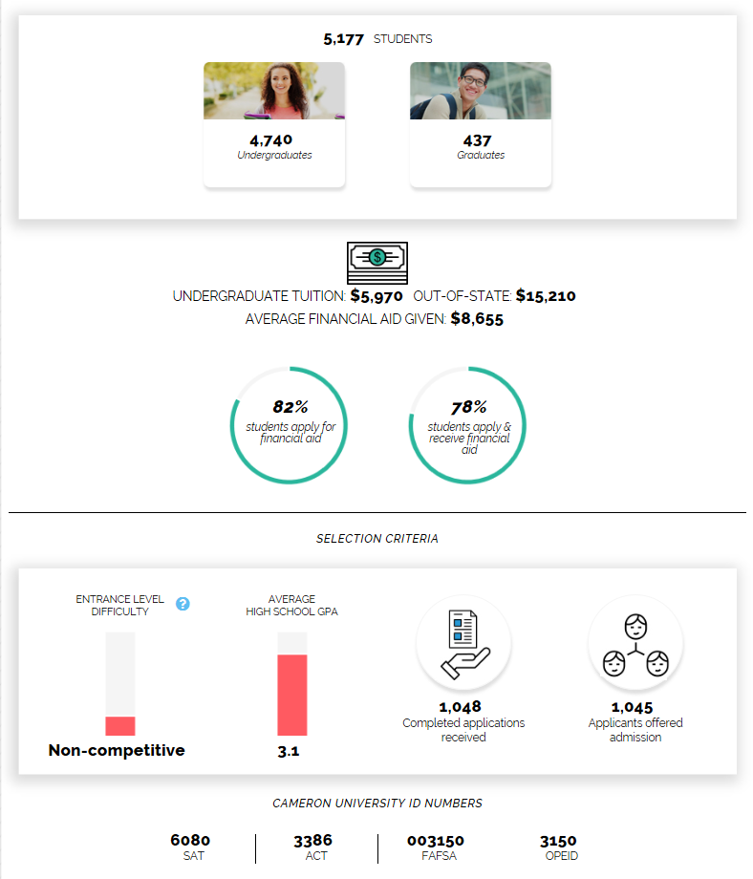
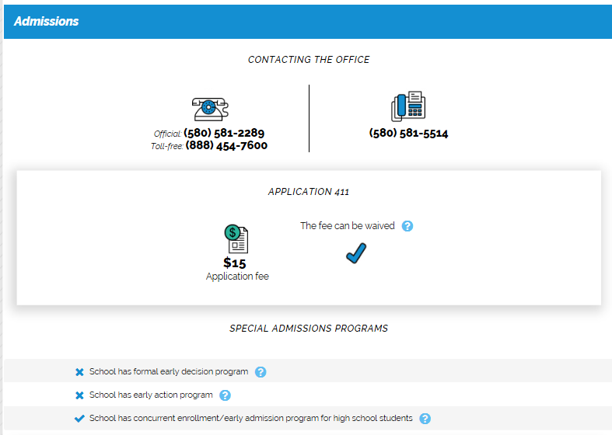
Compare Schools
Search for schools by name or by campus characteristics to find average tuition costs, application fees, admission criteria, and much more!

Slide 14
Check Them Out
Visit every college you’re strongly considering
Take a campus tour
Schedule interviews with several campus officials
Grab any necessary paperwork or forms
Visit dorms or on-campus apartments
Talk with current students about campus life
Explore the local area on your own
Notes:
Take advantage of your time on campus to talk to professors in your field of study, admissions, financial aid, and housing.

Slide 15
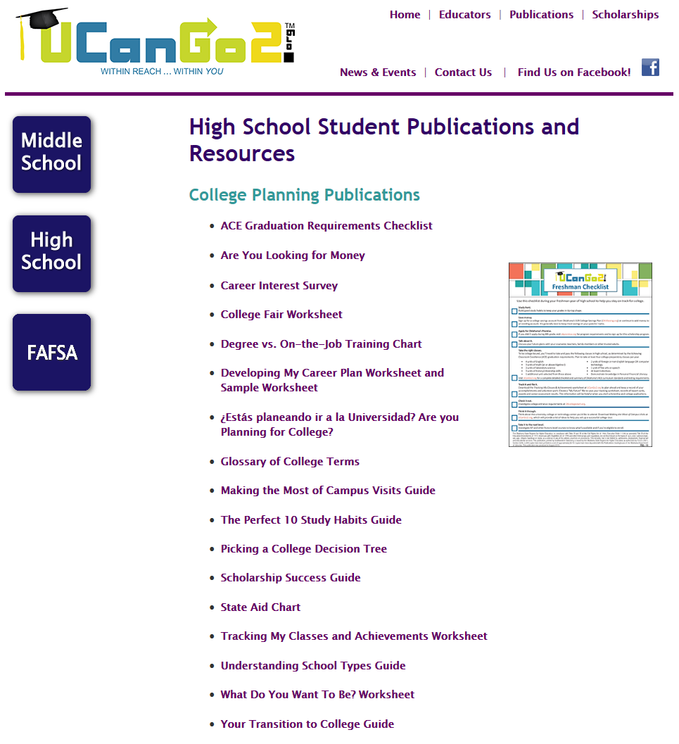
Notes:
In this section we’re highlighting the ‘Making the Most of Campus Visits Guide.’
These three forms offer you a lot of information on setting up a campus visit, questions to ask while you’re there, and an explanation of what many campus offices provide for you.

Slide 16
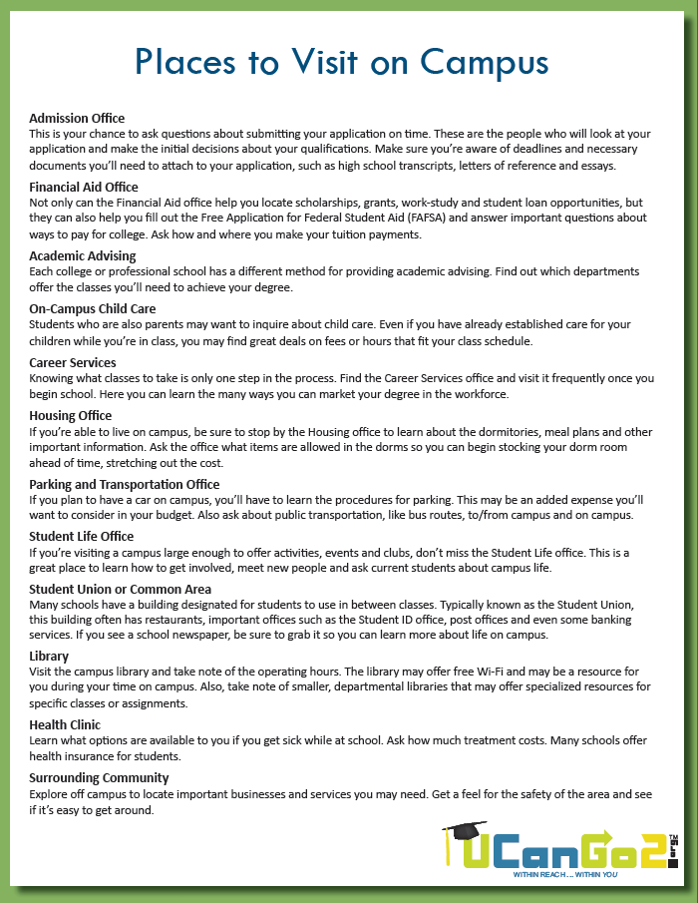
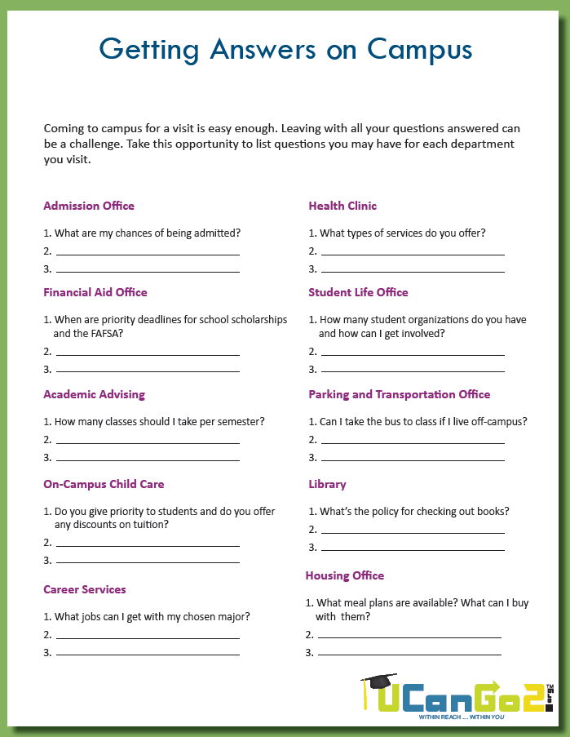
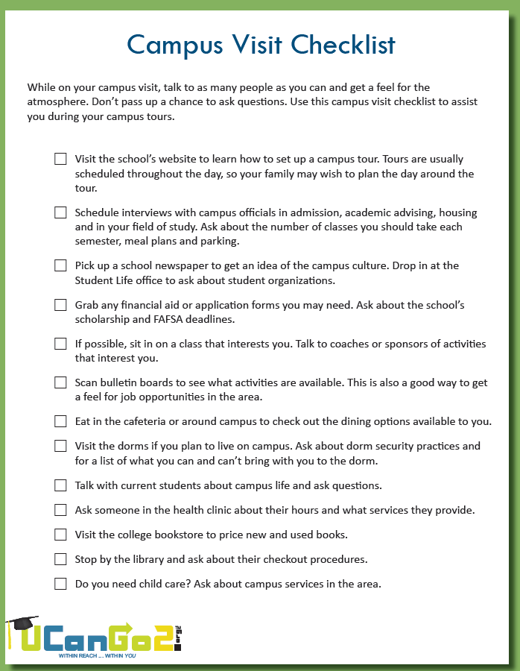
Notes:
Use these resources when planning and taking a campus tour at your favorite schools.

Slide 17
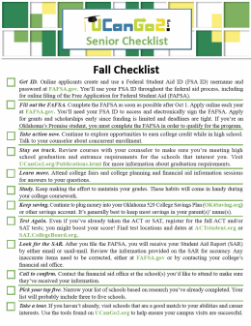
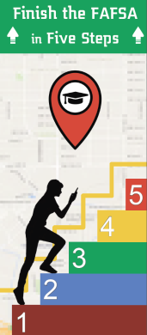
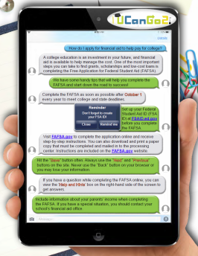
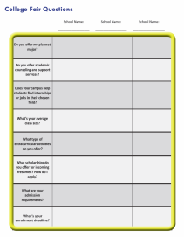
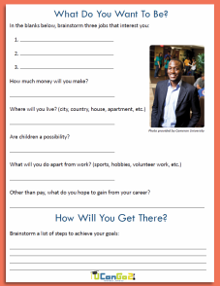
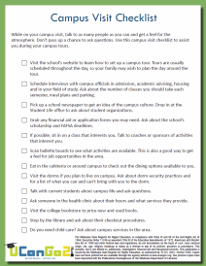
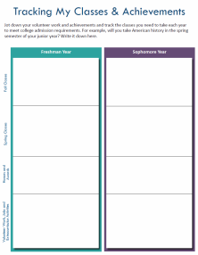
Helpful Publications
College Planning
Checklists
Finish the
FAFSA in
Five Steps
College
Terms
Glossary
Your Transition
to College
Brochure
Scholarship
Success Guide
FAFSA Facts
My Classes &
Achievements
Worksheet
High School
Student
Workbook
Are You
Looking
for Money?
What Do I
Want To Be?
Worksheet
Campus
Visit
Checklist
College Fair
Worksheet
Notes:
You’ll find all of these materials under the Publications link at UCanGo2.org.

Slide 18
Questions?

Slide 19
Contact Us
Oklahoma State Regents for Higher Education
Oklahoma College Assistance Program
Outreach Department

