Slide 1
Why Go to College?
Notes:
UCanGo2 is an initiative designed to provide information about planning, preparing and paying for college.
Workbooks and flyers are provided to students and parents and can be downloaded directly from our college access website, UCanGo2.org.

Slide 2
What is ?
College access program for high school and middle school students and parents
Provides information on how to plan, prepare and pay for college
Helps families create a college-going culture in the home
Notes:
UCanGo2 is an initiative of the Oklahoma College Assistance Program (OCAP) and the Oklahoma State Regents for Higher Education.
UCanGo2 offers college planning information to students and parents.
The Publications link houses several documents and resources that offer valuable tools for anyone considering higher education.
The Scholarship section allows all students to search for scholarships by deadline and category.

Slide 3
Notes:
UCanGo2.org allows users to access the information specific to their needs.
Each section provides resources for middle school and high school students, parents and counselors.
Most material can be located and downloaded from the Publications link.
Click on the StartWithFAFSA.org link to find valuable information about the Free Application for Federal Student Aid (FAFSA).

Slide 4
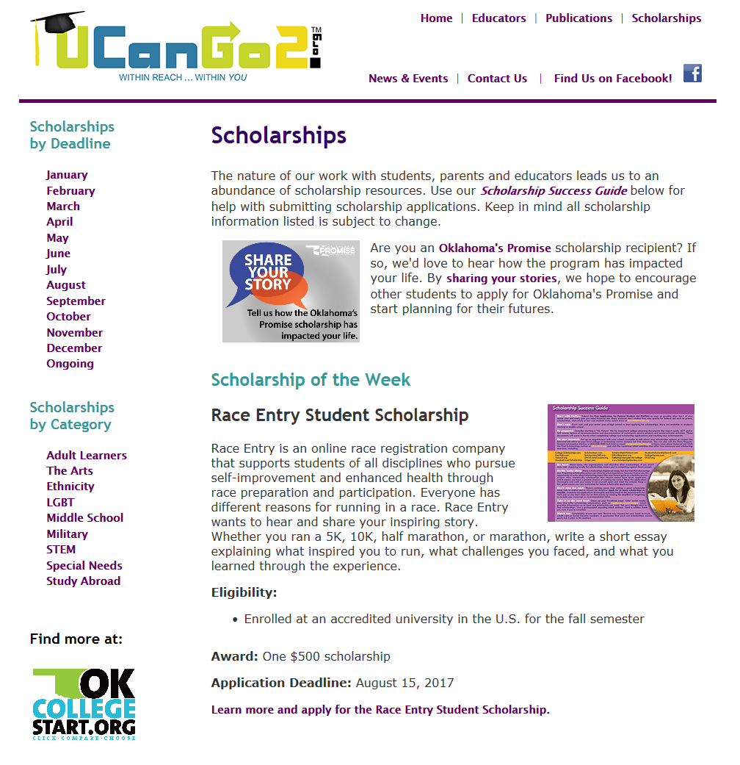
Notes:
In our Scholarship section, students will see the Scholarship of the Week, as well as links to scholarships by deadline and category.
At the end of each month’s scholarship descriptions, students will find a list of other scholarships due that particular month.
Scholarships by Category offers several options for students of all ages and interests.

Slide 5
High School Student Workbook
Why Go to College?
What Do I Want to Be?
How Do I Get There?
Where Do I Go?
How Do I Pay For It?
Notes:
The UCanGo2 High School Student Workbook covers five main areas of college planning.
This PowerPoint covers the first section, ‘Why Go To College?’
It discusses common myths about college and highlights the perks of getting a degree or certificate, including better job security, higher pay and greater job satisfaction.

Slide 6
To Go or Not To Go?
I don’t like high school.
Why would I want
to go to college?
More freedom
More choices
New opportunities
Notes:
Let’s tackle some common concerns.

Slide 7
To Go or Not To Go?
I don’t know what I want
to do with life so there’s
no point going to college.
College is a great opportunity to explore
new activities and learn about yourself.

Slide 8
To Go or Not To Go?
College is too expensive.
There’s no way I can afford it.
College can be costly in terms of tuition, books and time, but it’s a smart investment in your future.
You’ll be surprised by the abundance
of grants, scholarships and student
loans that are available.

Slide 9
What’s In It For Me?
Higher Income
Better Benefits
More Job Security
Empowers you to shape your future
Provides cultural diversity
Increases your intellectual understanding
Exposes you to different world views and philosophies
Notes:
Some additional benefits of an education are:
Enables you to make better consumer decisions
Offers higher job satisfaction
Provides opportunities to study in other countries
Offers friendships that can last a lifetime
Adds more exposure to sporting events, performances, clubs
Gives you an opportunity for more independence, freedom and responsibility
Can add to your hobbies and interests
May offer job mobility
College graduates are also said to earn greater than $1,000,000 more over their lifetime than a high school graduate.

Slide 10
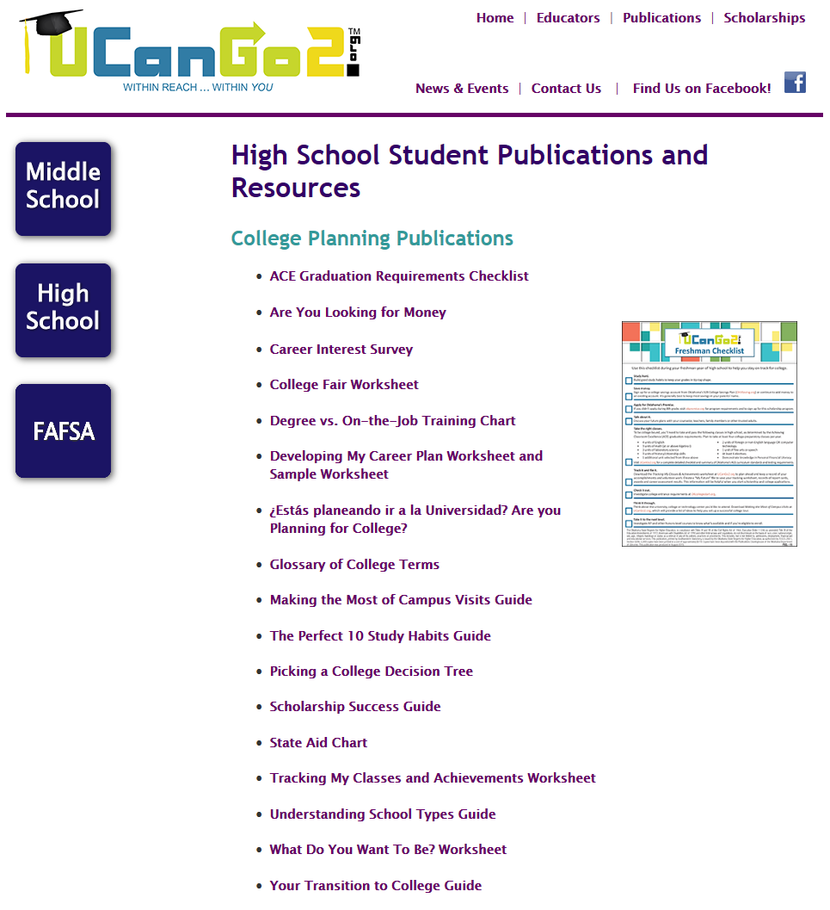
Notes:
Check out these publications on our website for other helpful college planning tools.
In this section of the Student Workbook, we’re highlighting the ‘Degree vs. On-the-Job Training Chart.’

Slide 11
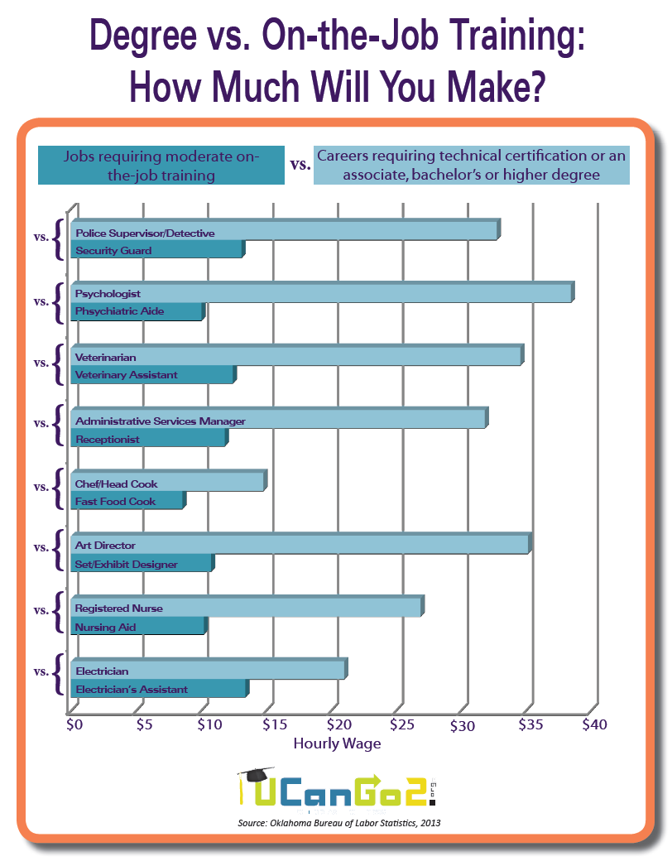
Notes:
This flyer compares similar jobs, but shows the salary differences based on the amount of education completed.

Slide 12
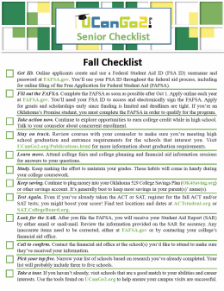
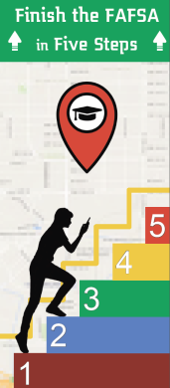
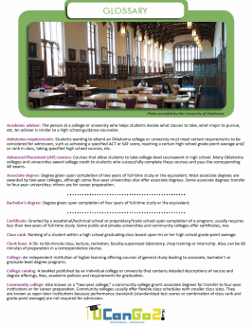
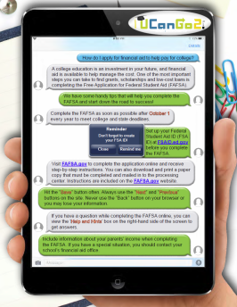
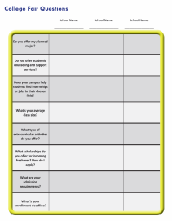
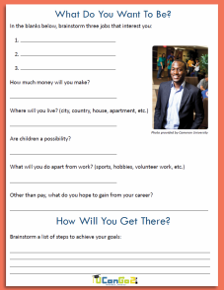
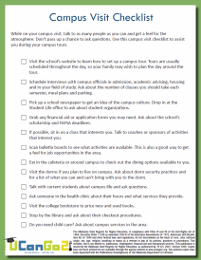
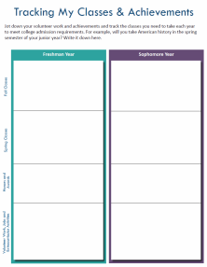
Helpful Publications
College Planning
Checklists
Finish the
FAFSA in
Five Steps
College
Terms
Glossary
Your Transition
to College
Brochure
Scholarship
Success Guide
FAFSA Facts
My Classes &
Achievements
Worksheet
High School
Student
Workbook
Are You
Looking
for Money?
What Do I
Want To Be?
Worksheet
Campus
Visit
Checklist
College Fair
Worksheet
Notes:
You’ll find all of these materials under the Publications link at UCanGo2.org.

Slide 13
Questions?

Slide 14
Contact Us
Oklahoma State Regents for Higher Education
Oklahoma College Assistance Program
Outreach Department

